Slide 1
Unified Modeling Language (UML)
UML is a general purpose modelling language.
The main aim of UML is to define a standard way to visualize the way a system has been designed.
It is quite similar to blueprints used in other fields of engineering.
UML is not a programming language, it is rather a visual language.
We use UML diagrams to portray the behavior and structure of a system.
UML helps software engineers, businessmen and system architects with modelling, design and analysis.

Slide 2
Object Management Group
The Object Management Group (OMG) adopted Unified Modelling Language as a standard in 1997.
Its been managed by OMG ever since.
International Organization for Standardization (ISO) published UML as an approved standard in 2005.
UML has been revised over the years and is reviewed periodically.

Slide 3
Need of UML
Complex applications need collaboration and planning from multiple teams and hence require a clear and concise way to communicate amongst them.
Businessmen do not understand code. So UML becomes essential to communicate with non programmers essential requirements, functionalities and processes of the system.
A lot of time is saved down the line when teams are able to visualize processes, user interactions and static structure of the system.

Slide 4
Introduction to UML Diagram
Diagrams in UML can be broadly classified as:
Structural Diagrams – Capture static aspects or structure of a system. Structural Diagrams include: Component Diagrams, Object Diagrams, Class Diagrams and Deployment Diagrams.
Behavior Diagrams – Capture dynamic aspects or behavior of the system. Behavior diagrams include: Use Case Diagrams, State Diagrams, Activity Diagrams and Interaction Diagrams.

Slide 5
Building Block Of UML
The building blocks of UML can be defined as :
Things
Relationships
Diagrams

Slide 6
Things
Things are the most important building blocks of UML. Things can be −
Structural
Behavioral
Grouping
Annotationa

Slide 7


Structural things
Structural things define the static part of the model. They represent the physical and conceptual elements. Following are the brief descriptions of the structural things.
Class − Class represents a set of objects having similar responsibilities.
Interface defines a set of operations, which specify the responsibility of a class.

Slide 8




Collaboration −Collaboration defines an interaction between elements.
Use case −Use case represents a set of actions performed by a system for a specific goal.
Component −Component describes the physical part of a system.
Node − A node can be defined as a physical element that exists at run time.

Slide 9


Behavioural thing
A behavioral thing consists of the dynamic parts of UML models. Following are the behavioral things −
Interaction − Interaction is defined as a behavior that consists of a group of messages exchanged among elements to accomplish a specific task.
State machine − State machine is useful when the state of an object in its life cycle is important. It defines the sequence of states an object goes through in response to events. Events are external factors responsible for state change

Slide 10

Grouping Things
It can be defined as a mechanism to group elements of a UML model together. There is only one grouping thing available −
Package − Package is the only one grouping thing available for gathering structural and behavioral things.

Slide 11

Annotational Things
Annotational things can be defined as a mechanism to capture remarks, descriptions, and comments of UML model elements.
Note - It is the only one Annotational thing available. A note is used to render comments, constraints, etc. of an UML element.

Slide 12


Relationship
Relationship is another most important building block of UML. It shows how the elements are associated with each other and this association describes the functionality of an application.
There are four kinds of relationships available.
Dependency: Dependency is a relationship between two things in which change in one element also affects the oth
Association: Association is basically a set of links that connects the elements of a UML model. It also describes how many objects are taking part in that relationship.

Slide 13


Generalization: Generalization can be defined as a relationship which connects a specialized element with a generalized element. It basically describes the inheritance relationship in the world of objects.
Realization: Realization can be defined as a relationship in which two elements are connected. One element describes some responsibility, which is not implemented and the other one implements them. This relationship exists in case of interfaces.

Slide 14
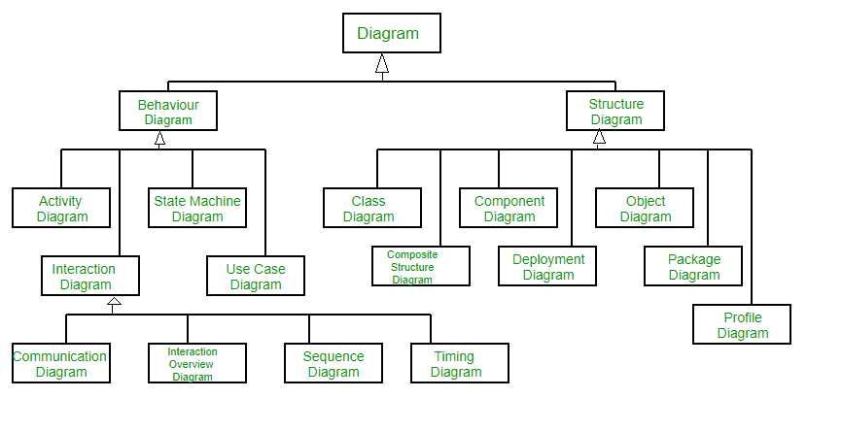
UML-Diagram

Slide 15
Structural UML Diagrams –
Class Diagram – The most widely use UML diagram is the class diagram.
It is the building block of all object oriented software systems.
We use class diagrams to depict the static structure of a system by showing system’s classes , their methods and attributes.
Class diagrams also help us identify relationship between different classes or objects.

Slide 16
Composite Structure Diagram-
We use composite structure diagrams to represent the internal structure of a class and its interaction points with other parts of the system.
A composite structure diagram represents relationship between parts and their configuration which determine how the classifier (class, a component, or a deployment node) behaves.

Slide 17
Object Diagram
An Object Diagram can be referred to as a screenshot of the instances in a system and the relationship that exists between them.
Since object diagrams depict behaviour when objects have been instantiated, we are able to study the behaviour of the system at a particular instant.
An object diagram is similar to a class diagram except it shows the instances of classes in the system.

Slide 18
Component Diagram
Component diagrams are used to represent the how the physical components in a system have been organized.
We use them for modelling implementation details.
Component Diagrams depict the structural relationship between software system elements and help us in understanding if functional requirements have been covered by planned development.
Component Diagrams become essential to use when we design and build complex systems.
Interfaces are used by components of the system to communicate with each other.

Slide 19
Deployment Diagram
Deployment Diagrams are used to represent system hardware and its software.
It tells us what hardware components exist and what software components run on them.

Slide 20
Package Diagram
We use Package Diagrams to depict how packages and their elements have been organized.
A package diagram simply shows us the dependencies between different packages and internal composition of packages.
Packages help us to organise UML diagrams into meaningful groups and make the diagram easy to understand.
They are primarily used to organise class and use case diagrams.

Slide 21
Behavior Diagrams –
State Machine Diagrams –
A state diagram is used to represent the condition of the system or part of the system at finite instances of time.
It’s a behavioral diagram and it represents the behavior using finite state transitions.
State diagrams are also referred to as State machines and State-chart Diagrams . These terms are often used interchangeably.
So simply, a state diagram is used to model the dynamic behavior of a class in response to time and changing external stimuli.

Slide 22
Activity Diagrams –
We use Activity Diagrams to illustrate the flow of control in a system.
We can also use an activity diagram to refer to the steps involved in the execution of a use case.
We model sequential and concurrent activities using activity diagrams.
Use Case Diagrams –
Use Case Diagrams are used to depict the functionality of a system or a part of a system.
They are widely used to illustrate the functional requirements of the system and its interaction with external agents(actors).
A use case is basically a diagram representing different scenarios where the system can be used.

Slide 23
Sequence Diagram –
A sequence diagram simply depicts interaction between objects in a sequential order i.e. the order in which these interactions take place.
We can also use the terms event diagrams or event scenarios to refer to a sequence diagram.
Sequence diagrams describe how and in what order the objects in a system function.
These diagrams are widely used by businessmen and software developers to document and understand requirements for new and existing systems.

Slide 24
Communication Diagram –
A Communication Diagram is used to show sequenced messages exchanged between objects.
A communication diagram focuses primarily on objects and their relationships.
Timing Diagram –
Timing Diagram are a special form of Sequence diagrams which are used to depict the behavior of objects over a time frame.
We use them to show time and duration constraints which govern changes in states and behavior of objects.

Slide 25
Use Case Diagrams
Use Case Diagrams are used to depict the functionality of a system or a part of a system.
They are widely used to illustrate the functional requirements of the system and its interaction with external agents(actors).
A use case is basically a diagram representing different scenarios where the system can be used.
A use case diagram gives us a high level view of what the system or a part of the system does without going into implementation details.

Slide 26


Notation for use-case diagram
Use cases: Horizontally shaped ovals that represent the different uses that a user might have.
Actors: Stick figures that represent the people actually employing the use cases.
System boundary boxes: A box that sets a system scope to use cases. All use cases outside the box would be considered outside the scope of that system.

Slide 27
Packages:
A UML shape that allows you to put different elements into groups.
Just as with component diagrams, these groupings are represented as file folders.

Slide 28

Use case relationship
Illustrate relationships between an actor and a use case with a simple line.
For relationships among use cases, use arrows labeled either "uses" or "extends.“
A "uses" relationship indicates that one use case is needed by another in order to perform a task.
An "extends" relationship indicates alternative options under a certain use case

Slide 29
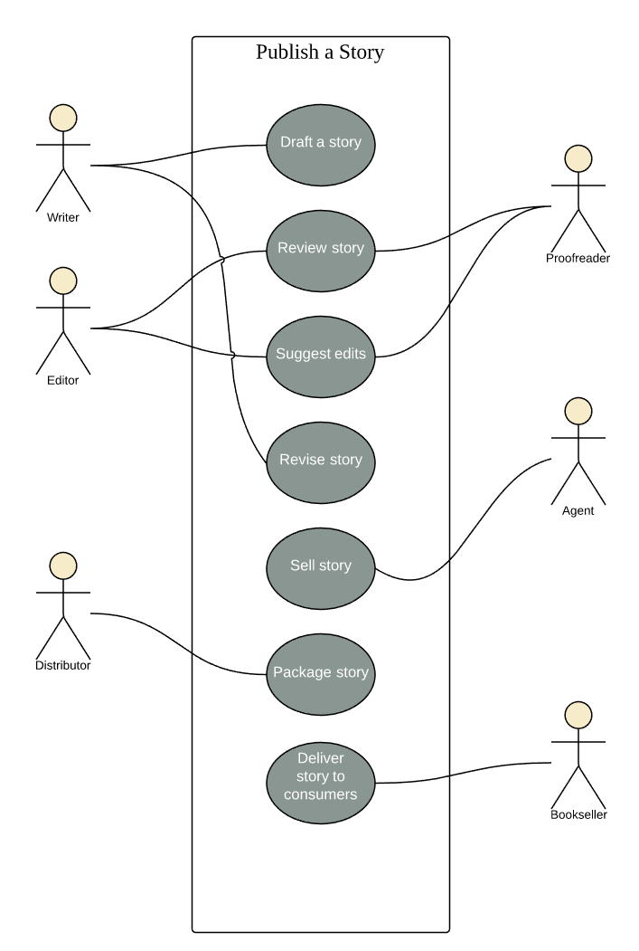
Sample Use case diagram

Slide 30
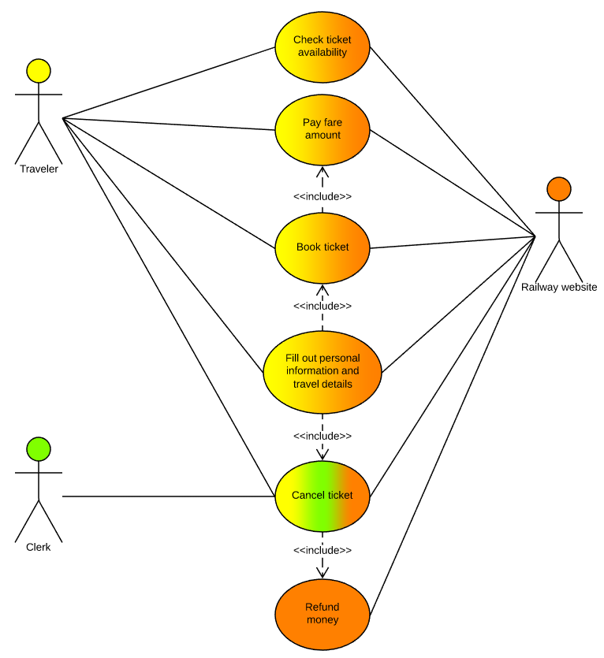
Use case diagram of railway reservation system

Slide 31
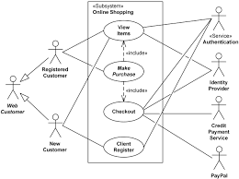

Slide 32
Advanced Class diagram
A classifier is a mechanism that has structural features as well as behavioral features.
Classifiers include classes, interfaces, datatypes, signals, components, nodes, use cases, and subsystems.
Those modeling elements that can have instances are called classifiers.
Every instance of a given classifier shares the same features.
The most important kind of classifier in UML is class.

